Slide 1

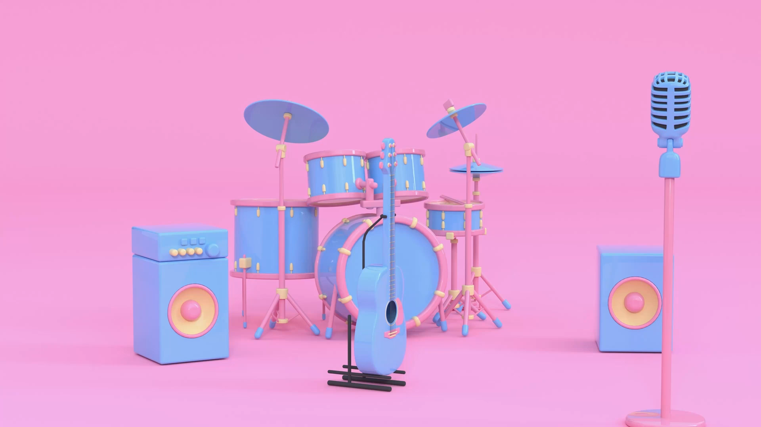
SONG ANALYSIS IN YOUTUBE
Presented By Abderrahim Haddeji
Mentorness Batch: MIP-DA-10

Slide 2
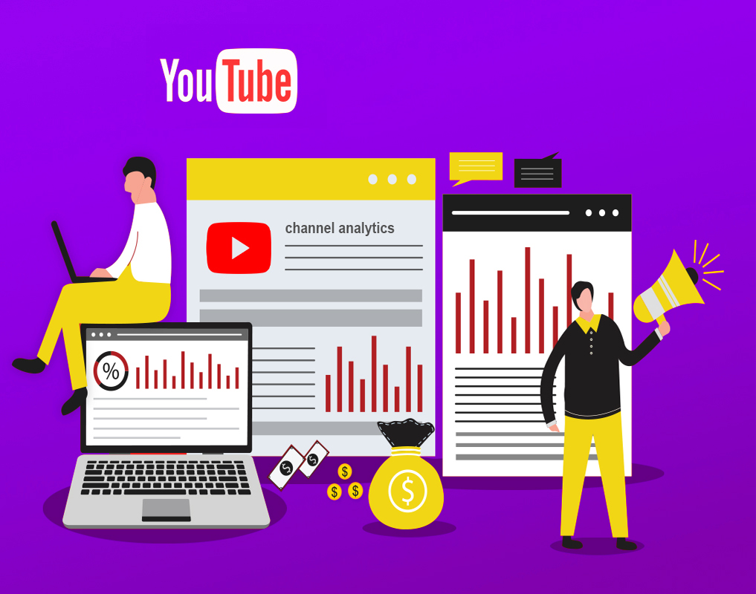

Problem Statement:
This internship project is focused on performing an in-depth analysis of YouTube song data using Power BI. The objective is to leverage Power BI to develop insightful visualizations and reports that provide a deeper understanding of the performance, popularity, and user engagement of YouTube songs. This analysis aims to identify trends, preferences, and patterns in the data to assist content creators and stakeholders in optimizing their YouTube song content.
Notes:
0:26—00:39

Slide 3
Dataset Description:
1. video_id: Unique identifier for each YouTube video.
2. channelTitle: Title of the YouTube channel publishing the song.
3. title: Title of the YouTube song video.
4. description: Description provided for the YouTube song video.
5. tags: Tags associated with the YouTube song video.
6. publishedAt: Date and time when the YouTube song video was published.
7. viewCount: Number of views received by the YouTube song video.
8. likeCount: Number of likes received by the YouTube song video.
9. favoriteCount: Number of times the YouTube song video has been marked as a favorite.
10. commentCount: Number of comments posted on the YouTube song video.
11. duration: Duration of the YouTube song video.
12. definition: Video definition or quality (e.g., HD, SD).
13. caption: Availability of captions for the YouTube song video.

Slide 4
MISSION STATEMENT
This project provides interns with hands-on experience in leveraging Power BI for meaningful analysis in
the dynamic domain of YouTube songs, contributing insights to optimize content strategy and
engagement.

Slide 5


Tools to use…

Slide 6
01
Data Cleaning and Preparation

Slide 7
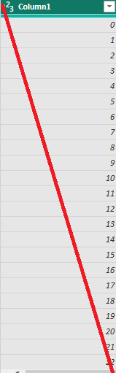
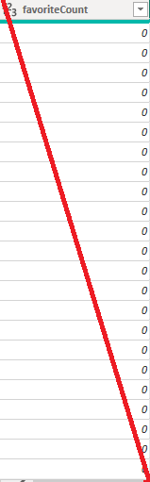
Data Cleaning
For data cleaning, we need to remove the index column (column 1) and the favorite count column because they are not necessary for our analysis and do not provide any useful information.
1. Go to the Data view or Power Query Editor.
2. Select the columns.
3. Click on Remove Columns.

Slide 8
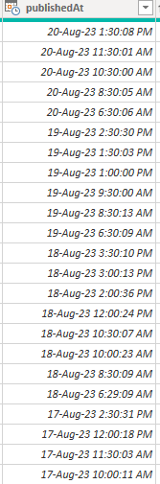
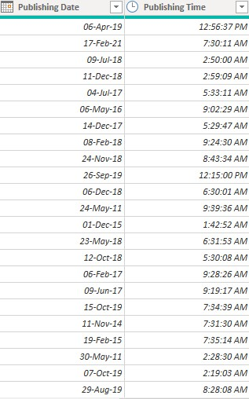
Additionally, the published date column contains both the date and time when the YouTube song video was published. We need to separate these into distinct columns to analyze the data more conveniently.

Slide 9
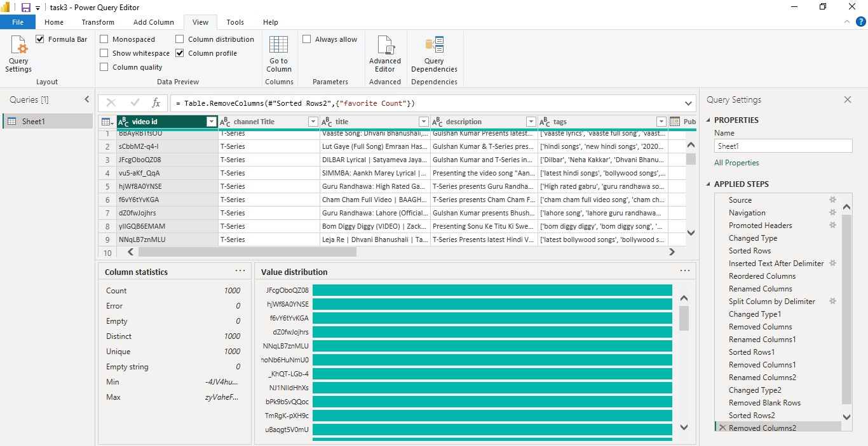
Data Cleaning
All columns in the dataset are free from errors and missing values. Additionally, all columns are correctly typed and in their appropriate data types.
There is no need to replace any values in the numerical columns because there are no missing values in them. Therefore, we do not need to use specific values, means, medians, or any other replacements.

Slide 10
02
ANALYSIS AND INSIGHTS

Slide 11
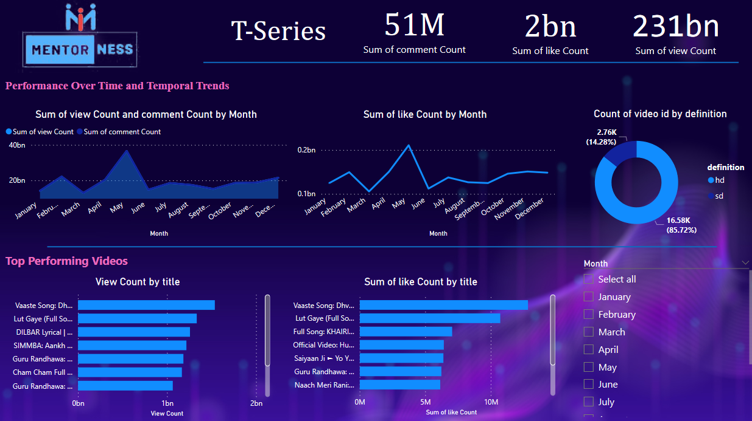

Slide 12
1) Performance Over Time and Temporal Trends:
The total view count and total comment count showed the greatest disparity in May, with the total view count surpassing the total comment count by 36,633,693,240.
2) User engagement:
The total sum of view count and total sum of comment count are positively correlated with each other across months.
- May represented 15.87% of the total sum of view count.
- The count of video IDs for HD (16,583) exceeded that for SD (2,762).
- HD accounted for 85.72% of the count of video IDs.
﻿﻿
3) Top Performing Videos:
"Vaaste Song" by Dhvani Bhanushali had the highest view count at 1,536,719,459, which was 63.15% higher than "Full Song: KHAIRIYAT (BONUS TRACK)" from CHHICHHORE at 941,903,968 views.
We have in total:
51 million comment count
2 billion sum of like count
231 billion sum of view count

Slide 13
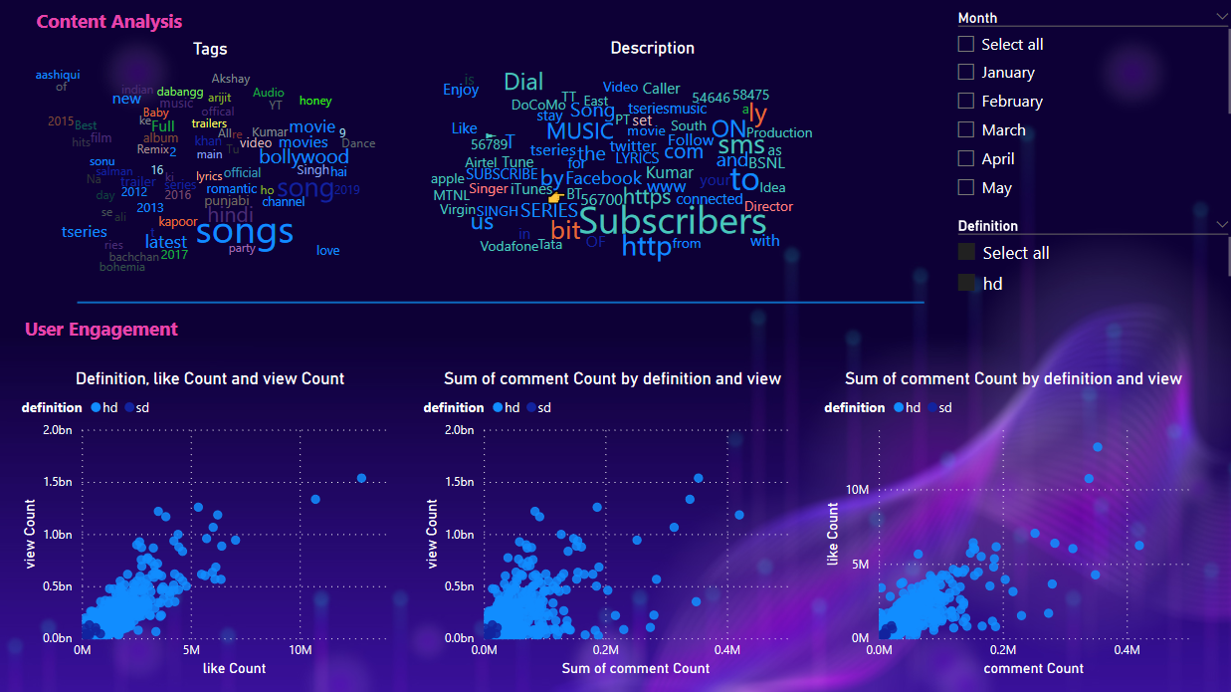

Slide 14

4) User engagement
The view count and like count are strongly correlated; as the view count increases, the like count also rises. Similarly, the view count and comment count show a strong positive correlation; higher view counts are associated with an increase in comments.
5) The Word Cloud
The two word clouds reveals that the most common themes in YouTube song videos are "songs," "Bollywood," "Punjabi," and "Hindi," indicating a strong preference for Bollywood and regional Indian music. Key players like T-Series ("tseries") and Bhushan Kumar ("buhsan") are prominent, highlighting their influence.
Popular content types include full albums, dance videos, and remixes, suggesting that viewers enjoy comprehensive and dynamic music content. Focusing on these genres and formats can maximize audience engagement and achieve more viewership

Slide 15
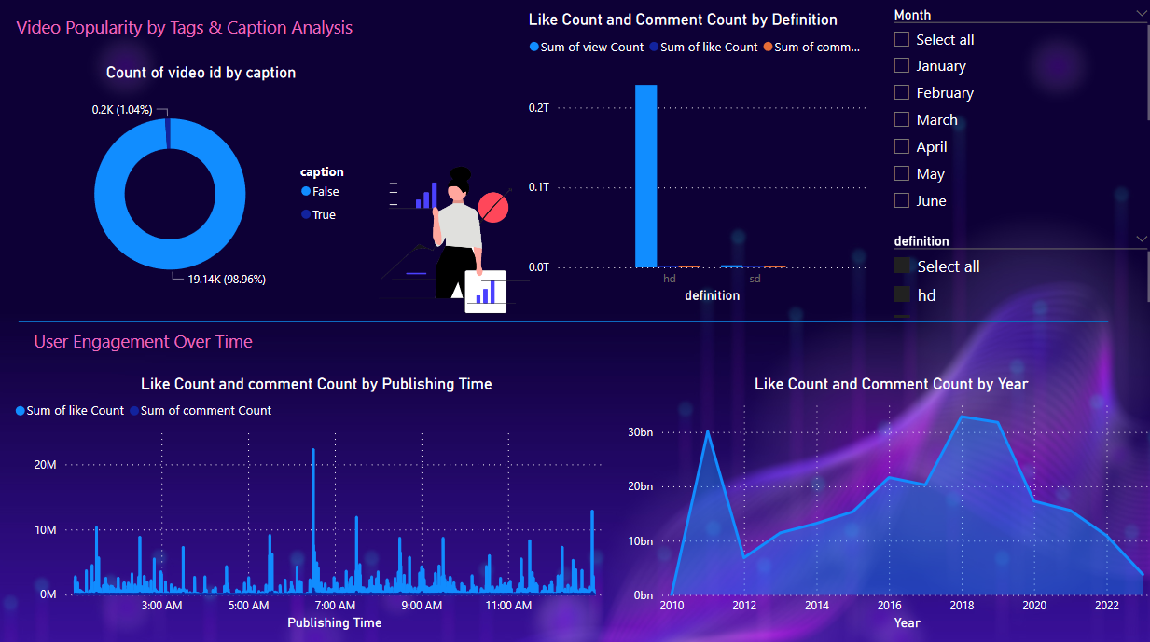

Slide 16
6) User engagement by tage and caption analysis:
The donut chart displaying the count of video IDs by caption reveals that the proportion of videos without captions is significantly higher than those with captions. Specifically, 98.96% of the videos do not have captions, while only 1.04% have captions.
7) User Engagement Over Time:
The line chart shows that the optimal time to post is precisely at 6:30 AM. During this timeframe, there is a significant increase in likes and comments (with a total of 22,275,322 likes and 871,957 comments), illustrating why YouTube song publishers prefer to publish their content during this period.
﻿﻿

Slide 17

8) User Engagement Over Time
The total view count experienced a significant upward trend, marking a remarkable 227,469.79% increase from 2010 to 2023.
Starting its ascent in 2010, the total view count surged by 411,455.46% (reaching 6,839,249,768) within just two years.
The most substantial increase in total view count occurred between 2010 and 2012, soaring from 1,662,209 to 6,840,911,977.
﻿﻿

Slide 18
03
Recommendations

Slide 19
1) Content Strategy and Trends:
Focus on producing content that aligns with the preferences indicated by the word cloud, such as Bollywood, Punjabi, and Hindi songs. Incorporate elements like full albums, dance videos, and remixes to cater to viewer preferences and maximize engagement.
2) User Engagement Optimization:
Leverage the strong positive correlations between view counts and both likes and comments. Encourage viewer interaction by continuing to post during optimal times like 6:30 AM, when there is a notable increase in engagement.
3) Video Production and Format:
- Given that HD videos significantly outnumber SD videos (85.72% vs. 14.28% of video IDs), prioritize producing content in HD format to maintain viewer interest and satisfaction.

Slide 20
4) Top Performing Videos Insights:
Emulate the success of top-performing videos like "Vaaste Song" by Dhvani Bhanushali, which garnered high view counts. Analyze what elements contribute to their success and integrate similar strategies into future content creation efforts.
5) Overall Performance Metrics:
Continue monitoring and optimizing performance metrics, considering the substantial increases in view counts observed over recent years (227,469.79% increase from 2010 to 2023). Use these insights to refine content strategies and maintain growth in viewer engagement and reach.

Slide 21
Thank you for your attention

Slide 22
Really Thank you…

